Slide 1
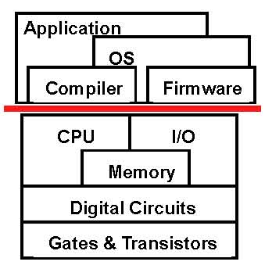
Instruction Set Architecture
Instruction Set Architecture (ISA)
  What is an ISA?
  A functional contract
All ISAs similar in high-level ways
  But many design choices in details
  Two “philosophies”: CISC/RISC
    Difference is blurring
Good ISA…
  Enables high-performance
  At least doesn’t get in the way
Compatibility is a powerful force
  Tricks: binary translation, μISAs

Slide 2
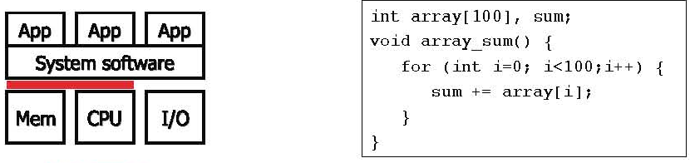
Program Compilation
Program written in a “high-level” programming language
  C, C++, Java, C#
  Hierarchical, structured control: loops, functions, conditionals
  Hierarchical, structured data: scalars, arrays, pointers, structures
Compiler: translates program to assembly
  Parsing and straight-forward translation
  Compiler also optimizes
  Compiler itself another application … who compiled compiler?

Slide 3
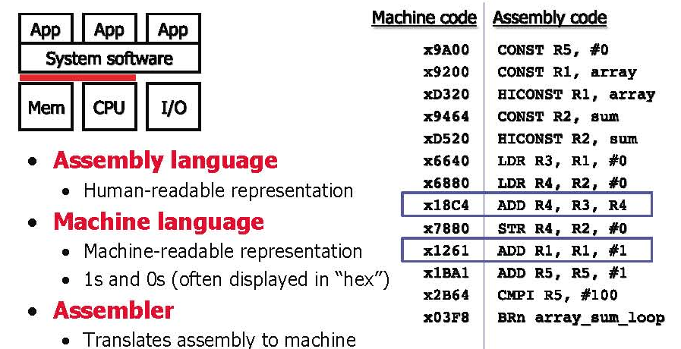
Assembly & Machine language

Slide 4
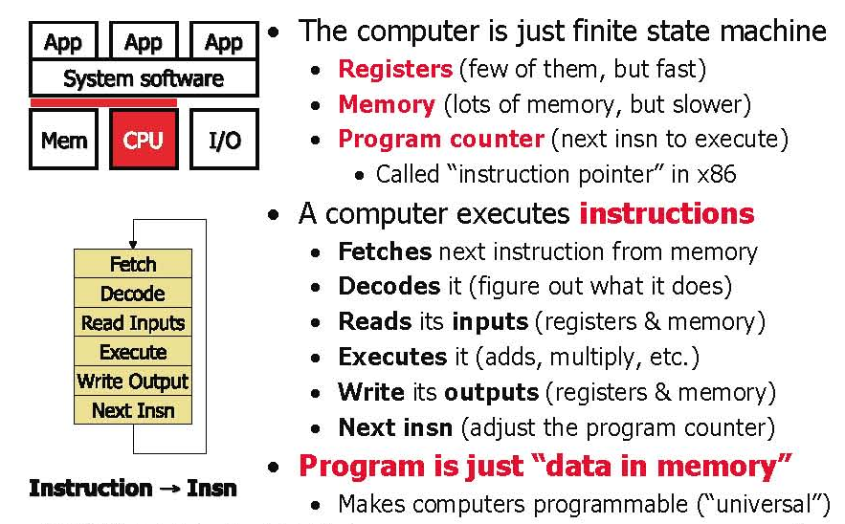
Instruction Execute Model

Slide 5
Performance
How long does it take for a program to execute?
  Three factors
How many insn must execute to complete program?
  Instructions per program during execution
  Dynamic insn count” (not number of “static” insns in program)
How quickly does the processor “cycle”?
  Clock frequency (cycles per second) 1 gigahertz (Ghz) or expressed as reciprocal, Clock period nanosecond (ns)
  Worst-case delay through circuit for a particular design
How many cycles does each instruction take to execute?
  Cycles per Instruction (CPI) or reciprocal, Insn per Cycle (IPC)

Slide 6
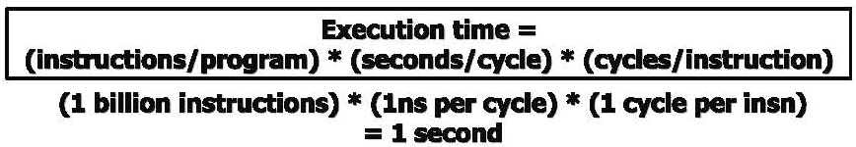
Maximize the Performance
Instructions per program:
  Determined by program, compiler, instruction set architecture (ISA)
Cycles per instruction: “CPI”
  Typical range today: 2 to 0.5
  Determined by program, compiler, ISA, micro-architecture
Seconds per cycle: “clock period”
  Typical range today: 2ns to 0.25ns
  Reciprocal is frequency: 0.5 Ghz to 4 Ghz (1 Htz = 1 cycle per sec)
  Determined by micro-architecture, technology parameters
For minimum execution time, minimize each term
  Difficult: often pull against one another

Slide 7
What is an ISA?
ISA (instruction set architecture)
  A well-defined hardware/software interface
  The “contract” between software and hardware
    Functional definition of storage locations & operations
      Storage locations: registers, memory
      Operations: add, multiply, branch, load, store, etc
    Precise description of how to invoke & access them
Not in the “contract”: non-functional aspects
  How operations are implemented
  Which operations are fast and which are slow and when
  Which operations take more power and which take less
Instructions
  Bit-patterns hardware interprets as commands
  Instruction ! Insn (instruction is too long to write in slides)

Slide 8
A language analogy for ISAs
Communication
  Person-to-person ! software-to-hardware
Similar structure
  Narrative ! Program
  Sentence ! Insn
  Verb ! operation (add, multiply, load, branch)
  Noun ! data item (immediate, register value, memory value)
  Adjective ! addressing mode
Many different languages, many different ISAs
  Similar basic structure, details differ (sometimes greatly)
Key differences between languages and ISAs
  Languages evolve organically, many ambiguities, inconsistencies
  ISAs are explicitly engineered and extended, unambiguous

Slide 9
The Sequential Model
Basic structure of all modern ISAs
  Often called VonNeuman, but in ENIAC before
Program order: total order on dynamic insns
  Order and named storage define computation
Convenient feature: program counter (PC)
  Insn itself stored in memory at location pointed to by PC
  Next PC is next insn unless insn says otherwise
Processor logically executes loop at left
Atomic: insn finishes before next insn starts
  Can break this constraint physically (pipelining)
  But must maintain illusion to preserve programmer sanity

Slide 10
ISA and Performance
Performance equation:
  (instructions/program) * (seconds/cycle) * (cycles/instruction)
A good ISA helps balances three three aspects
One example:
  Big complicated instructions:
    Reduce “insn/program” (good!)
    Increases “cycles/instruction” (bad!)
  Simpler instructions
    Reverse of above
We’ll revisit this when we talk about “RISC” vs “CISC”

Slide 11
Compiler Optimization
Primarily reduce insn count
  Eliminate redundant computation,
  Keep more things in registers
    Registers are faster, fewer loads/stores
    An ISA can make this difficult by having too few registers
But also… (more talk a bit about these later on)
  Reduce branches and jumps
  Reduce cache misses
  Reduce dependences between nearby insns
    An ISA can make this difficult
How effective are these?
  Can give 4X performance over unoptimized code
  Collective wisdom of 40 years (“Proebsting’s Law”): 4% per year
  Funny but … shouldn’t leave 4X performance on the table

Slide 12
Aspect of ISAs
Format
  Length and encoding
Operand model
  Where (other than memory) are operands stored?
Datatypes
Operations
  How many ops?
  What can they do?
  How complex are they?
Addressing modes (later…)
RISC v CISC (later)

Slide 13
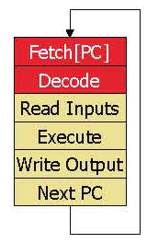
Length & Encoding
Length
  Fixed length
    Most common is 32 bits
    Simple implementation (next PC often just PC+4)
    Code density: 32 bits to increment a register by 1
  Variable length
    Code density
      x86 can do increment in one 8-bit instruction
      Complex fetch (where does next instruction begin?)
    Compromise: two lengths
      E.g., MIPS16 or ARM’s Thumb
Encoding
  A few simple encodings simplify decoder
    x86 decoder one nasty piece of logic

Slide 14
Simple Instruction Format
Arahan
4
6
6
Operand
Reference 1
Operand
Reference 2
Op-Code
Operand field
16 bits

Slide 15
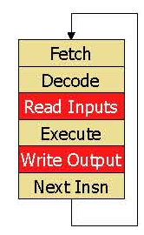
Where Does Data Live?
Registers
  “short term memory”
  Faster than memory, quite handy
  Named directly in instructions
Memory
  Fundamental storage space
  “longer term memory”
  Location to read or write calculated from registers
Immediates
  Values spelled out as bits in instructions
  Input only

Slide 16
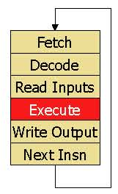
Datatypes
Datatypes
  Software: attribute of data
  Hardware: attribute of operation, data is just 0/1’s
All processors support
  Integer arithmetic/logic (8/16/32/64-bit)
  IEEE754 floating-point arithmetic (32/64-bit)
More recently, most processors support
  “Packed-integer” insns, e.g., MMX
  “Packed-fp” insns, e.g., SSE/SSE2
  For multimedia, more about these later
Other, infrequently supported, data types
  Decimal and other fixed-point arithmetic

Slide 17
Types of Operation
Perpindahan data (Data transfer)
Arithmetic
Logical
Pertukaran (Conversion)
I/O
Kawalan sistem (System control)
Transfer of control

Slide 18
Types of Operation
Data Transfer
  Specify
    Sumber (Source)
    Destinasi (Destination)
    Amount of data
  The two forms of the mov instruction take the following forms:
    mov reg, reg/memory/constant
    mov memory, reg
Arithmetic
  Add, Subtract, Multiply, Divide
  Signed Integer
  Floating point ?
  May include
    Increment (a++)
    Decrement (a--)
    Negate (-a)

Slide 19
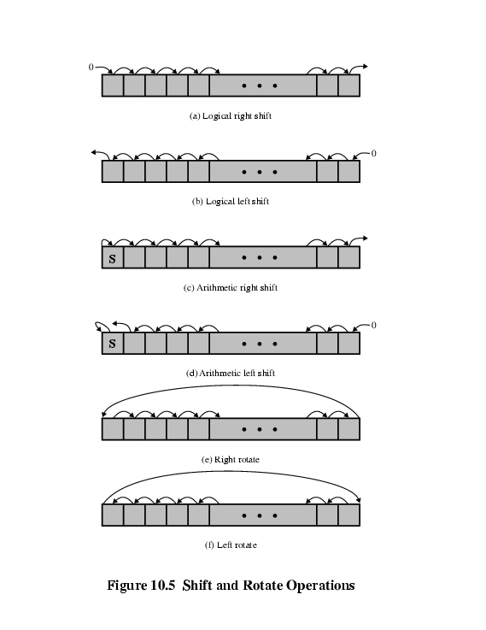
Types of Operation
  Shift and Rotate Operations
Logical
  Bitwise operations
  And, or, not

Slide 20
Types of Operation
Conversion
  E.g. Binary to Decimal
Input Output
  May be specific instructions
  May be done using data movement instructions (memory mapped)
  May be done by a separate controller (DMA)
System Control
  System control instruction
    Can be executed only while the processor is in a certain privileged state.
      Ring 0 on 80386+
      Kernel mode
    For operating systems use
  Exp:
    A system control may read or alter a control register.
    Access to process control blocks in a multiprogramming system.

Slide 21
Types of Operation
Transfer of Control
  Cabang (Branch)
    E.G.
    BRZ X ;Branch to x if result is zero
  Langkau (Skip)
    E.G. Increment and Skip if Zero
    ISZ R1
  Panggil subrutin (Subroutine call)
    Interrupt call
  ABC proc
  ……
  ABC endp
  call ABC

Slide 22
How Many Explicit Register Operands
Operand model: how many explicit operands
  3: general-purpose
    add R1,R2,R3 means: R1 = R2 + R3 (MIPS uses this)
  2: multiple explicit accumulators (output doubles as input)
    add R1,R2 means: R1 = R1 + R2 (x86 uses this)
  1: one implicit accumulator
    add R1 means: ACC = ACC + [R1]
  4+: useful only in special situations
    Fused multiply & accumulate instruction
Why have fewer?
  Primarily code density (size of each instruction in program binary)

Slide 23
How Many Register?
Registers faster than memory, have as many as possible?
  No
One reason registers are faster: there are fewer of them
  Small is fast (hardware truism)
Another: they are directly addressed (no address calc)
  More registers, means more bits per register in instruction
  Thus, fewer registers per instruction or larger instructions
Not everything can be put in registers
  Structures, arrays, anything pointed-to
  Although compilers are getting better at putting more things in
More registers means more saving/restoring
  Across function calls, traps, and context switches
Trend: more registers: 8 (x86) ! 32 (MIPS) ! 128 (IA64)
  64-bit x86 has 16 64-bit integer and 16 128-bit FP registers

Slide 24
How are memory locations specified?
Registers are specified directly
  Register names are short, can be encoded in instructions
  Some instructions implicitly read/write certain registers
How are addresses specified?
  Addresses are as big or bigger than insns
  Addressing mode: how are insn bits converted to addresses?
  Think about: what high-level idiom addressing mode captures

Slide 25
Memory Addressing Modes
Addressing mode: way of specifying address
  Used in memory-memory or load/store instructions in register ISA
Examples
  Displacement: R1=mem[R2+immed]
  Index-base: R1=mem[R2+R3]
  Memory-indirect: R1=mem[mem[R2]]
  Auto-increment: R1=mem[R2], R2= R2+1
  Auto-indexing: R1=mem[R2+immed], R2=R2+immed
  Scaled: R1=mem[R2+R3*immed1+immed2]
  PC-relative: R1=mem[PC+imm]
What high-level program idioms are these used for?
What implementation impact? What impact on insn count?

Slide 26
Number of Addresses (a)
3 addresses
  Operand 1, Operand 2, Result
  a = b + c;
  Not common
  Needs very long words to hold everything
2 addresses
  One address doubles as operand and result
  a = a + b
  Reduces length of instruction
  Requires some extra work
    Temporary storage to hold some results
Notes:
7

Slide 27
Number of Addresses (c)
1 address
  Implicit second address
  Usually a register (accumulator)
  Common on early machines
0 (zero) addresses
  All addresses implicit
  Uses a stack
  e.g. push a
  push b
  add
  pop c
  c = a + b
Notes:
9

Slide 28
Number of Addresses
One Address’s machine
  Add b => ac = ac + b
Two Addresses’s machine
  Sub a, b => a = a - b
Three Addresses’s machine
  Add a, b, c => a = b + c

Slide 29
Number of Addresses
Three Addresses’s Intruction
  Arahan komen/makna
  Sub y, a, b y<= a-b
  MPY t, d, e t<= d*e
  Add t, t, c t<= t+c
  Div y, y, t y<= y/t
        Y= (a-b) / (c+d*e)

Slide 30
Number of Addresses
Two Addresses’s Intruction
  MOV y, a y<= a
  Sub y, b y<= y-b
  MOV t, d t<= d
  MPY t, e t<= t*e
  Add t, c t<= t+c
  Div y, t y<= y/t
        Y= (a-b) / (c+d*e)

Slide 31
Number of Addresses
One Address’s Intruction
  LOD d ac<= d
  MPY e ac<= ac*e
  Add c ac<=ac+c
  STR y y<= ac
  LOD a ac<= a
  Sub b ac<= ac-b
  Div y ac<= ac/y
  STR y y<= ac
        Y= (a-b) / (c+d*e)

Slide 32
How Many Addresses
More addresses
  More complex (powerful?) instructions
  More registers
    Inter-register operations are quicker
  Fewer instructions per program
Fewer addresses
  Less complex (powerful?) instructions
  More instructions per program
  Faster fetch/execution of instructions
Notes:
11

Slide 33
RISC or CISC
CISC (Complex Instruction Set Computing)
  Reduce “instructions/program” with “complex” instructions
  But tends to increase CPI or clock period
  Easy for assembly-level programmers, good code density
• RISC (Reduced Instruction Set Computing)
  Improve “cycles/instruction” with many single-cycle instructions
  Increases “instruction/program”, but hopefully not as much
    Help from smart compiler
  Perhaps improve clock cycle time (seconds/cycle)
    via aggressive implementation allowed by simpler insn

Slide 34
ISA Design Goals
Programmability
  Easy to express programs efficiently?
Implementability
  Easy to design high-performance implementations?
  More recently
    Easy to design low-power implementations?
    Easy to design high-reliability implementations?
    Easy to design low-cost implementations?
Compatibility
  Easy to maintain programmability (implementability) as languages and programs (technology) evolves?
  x86 (IA32) generations: 8086, 286, 386, 486, Pentium, PentiumII,PentiumIII, Pentium4, Core2…

Slide 35
Summary
Computer Architecture includes the design of the Instruction Set Architecture (programmer's view) and the Machine Organization (logic designer’s view).
Levels of abstraction, which consist of an interface and an implementation are useful to manage designs.
Processor performance increases rapidly, but the speeds of memory and I/0 have not kept pace.
Computer systems are comprised on datapath, memory, input devices, output devices, and control.

